Slide 1
Biol4110
Ecological (Data Science) Methods

Slide 2
Notes:
I think it’s important to tell you how I come to this work. I grew up as a settler on the on the traditional, ancestral, and unceded territory of the Coast Salish peoples, including the Squamish, Tsleil Waututh and Musqueum Nations. For me, as an ecologist and a biodiversity scientist, it’s important to recognize that the biodiversity that exists within these traditional territories exists because of thousands of years of stewardship and effective management by Coast Salish people, in the past, present and future.
What you’re looking at here is not any old stretch of shoreline, this is a clam garden, an ancient form of aquaculture that Coast Salish people used to maintain high levels of shellfish productivity and diversity in intertidal zone.

Slide 3
“When the tide goes out, the table is set”
Chief Leah George-Wilson, Tsleil-Watuth
Notes:
The abundance of these shoreline is reflected in one of my favourite traditional Coast Salish sayings “When the tide goes out, the table is set”

Slide 4
“When the tide goes out, the table is set”
Ecosystem
Human well-being
Change
Changing, living coastal system
Chief Leah George-Wilson, Tsleil-Watuth
Notes:
And what I really like about this saying is that it evokes a a living system in which human well being and ecosystem health are intricately linked, not only though the food benefits provided by the shellfish, but also all the cultural and spiritual benefits.
The other component here “When the tide goes out” evokes a changing dynamic living system.

Slide 5
Bernhardt and Leslie, 2013, Annual Review of Marine Science
Singh, Hilmi, Bernhardt et al. 2019, People and Nature
Fishers in Madagascar (Credit: artush)
Notes:
Coastal ecosystems support human well being and livelihoods around the world,

Slide 6
Climate change is pushing the Sustainable Development Goals further out of reach
Bernhardt and Leslie, 2013, Annual Review of Marine Science
Singh, Hilmi, Bernhardt et al. 2019, People and Nature
Fishers in Madagascar (Credit: artush)
Notes:
and these systems are now experiencing rapid planetary scale change and we now know that this change is threatening the ability of these systems to support livelihoods as captured in the UN Sustainable Development Goals.

Slide 7
How do living systems, across scales, respond to environmental change?
Notes:
And so, Understanding how living systems, at multiple scales, respond to environmental change, is arguably the most important scientific challenge we face over the century.
This is the focus of my work

Slide 8




How do living systems, across scales, respond to environmental change?
Mechanistic understanding of global change in ecosystems
Consequences of ecological change for fisheries & human health
Notes:
I aim to develop a mechanistic understanding of global change in aquatic systems, and the consequences of those change for seafood and human nutrition.

Slide 9
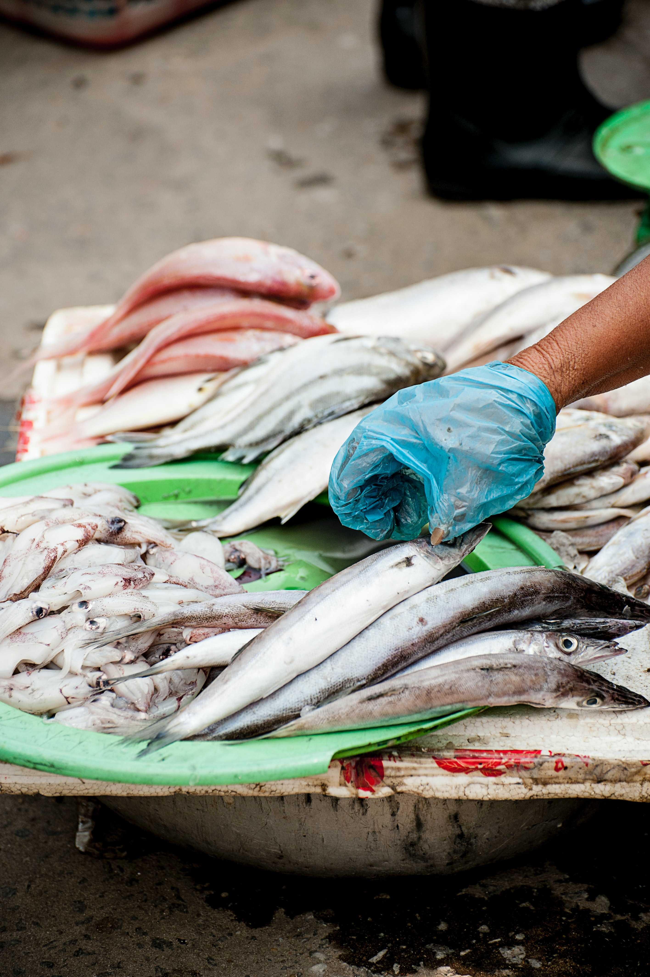
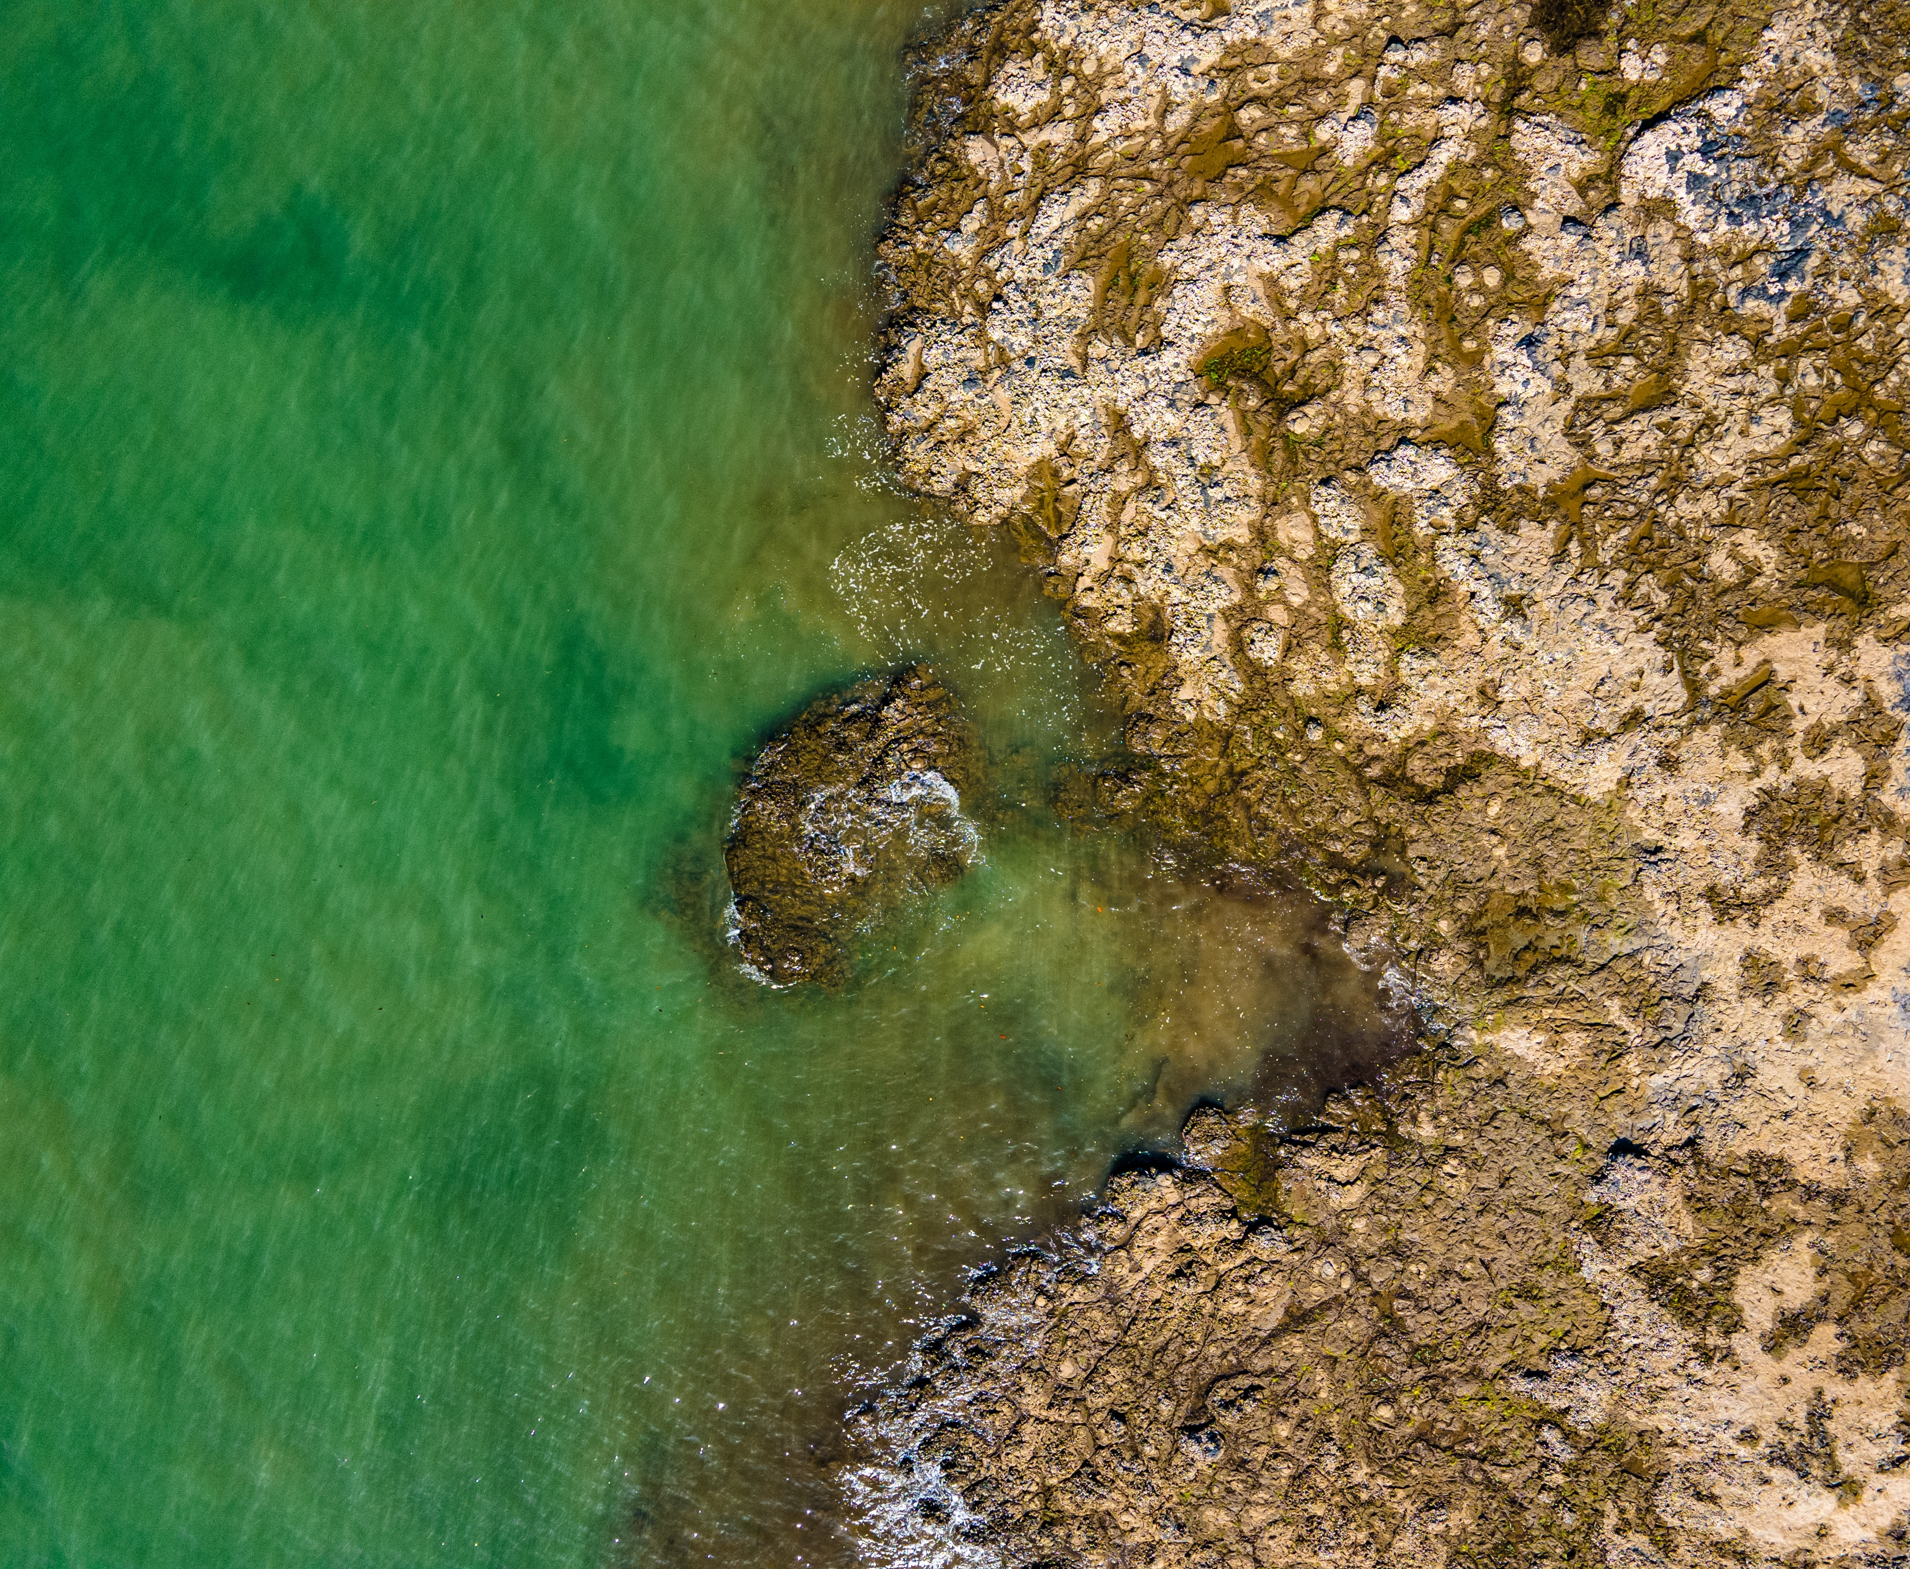
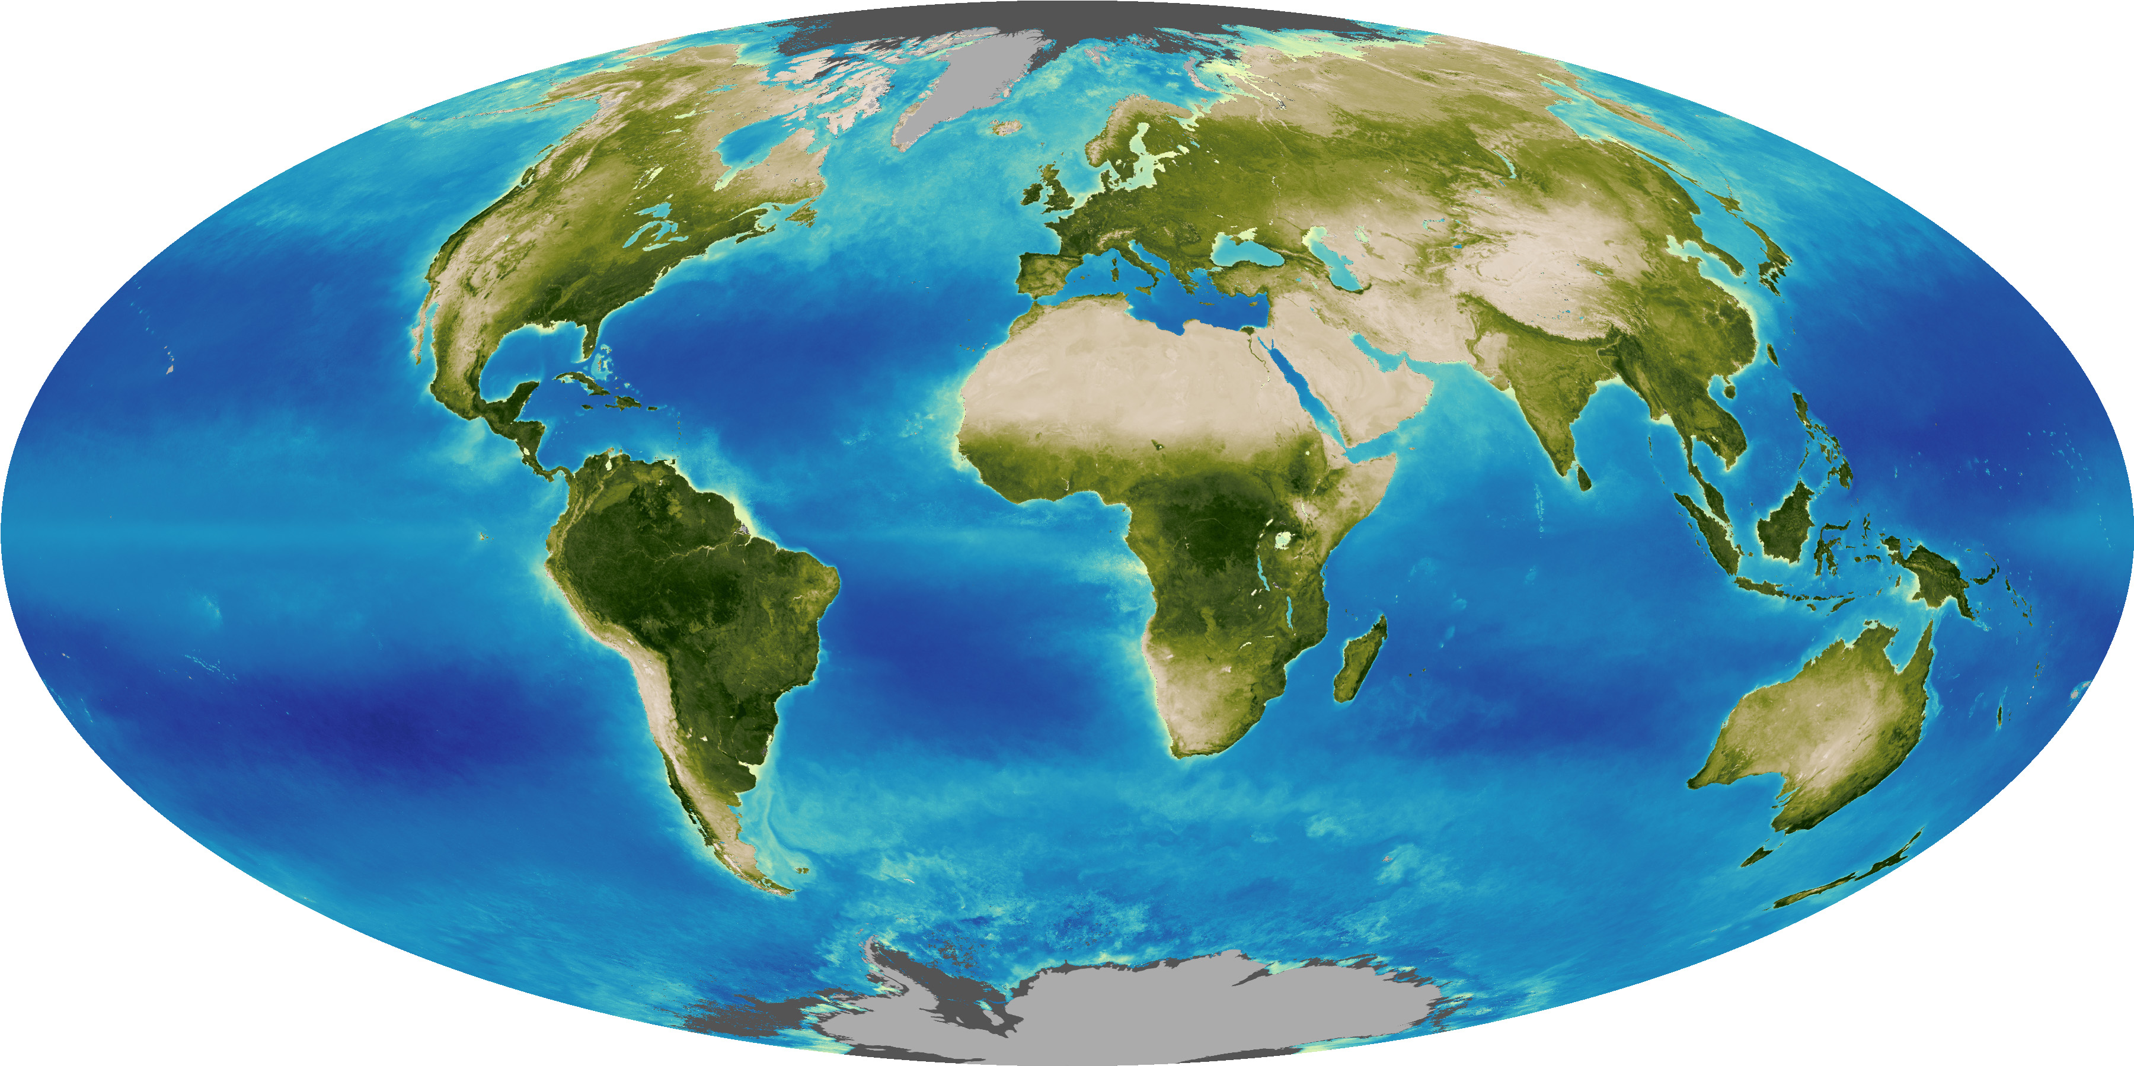
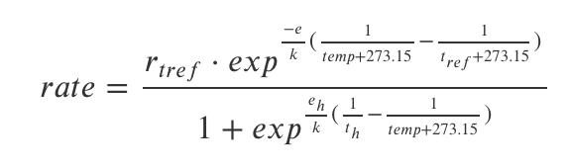
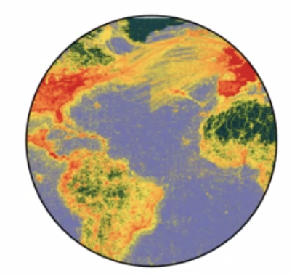
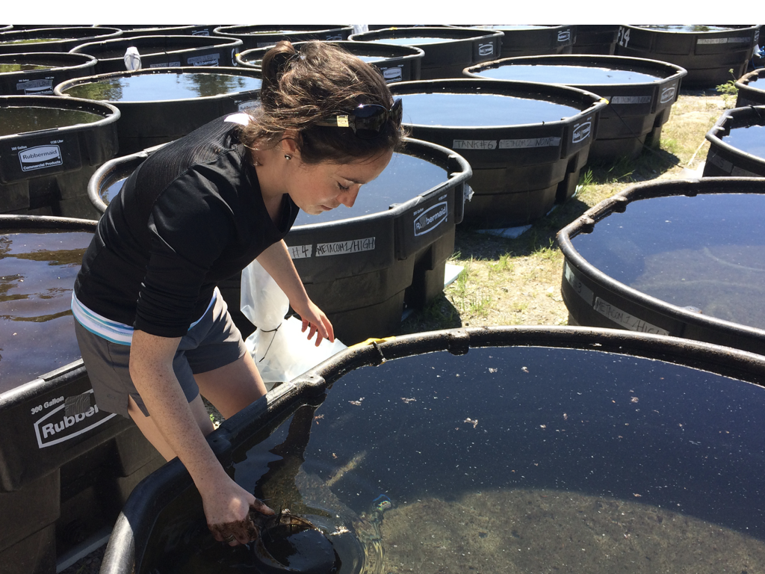
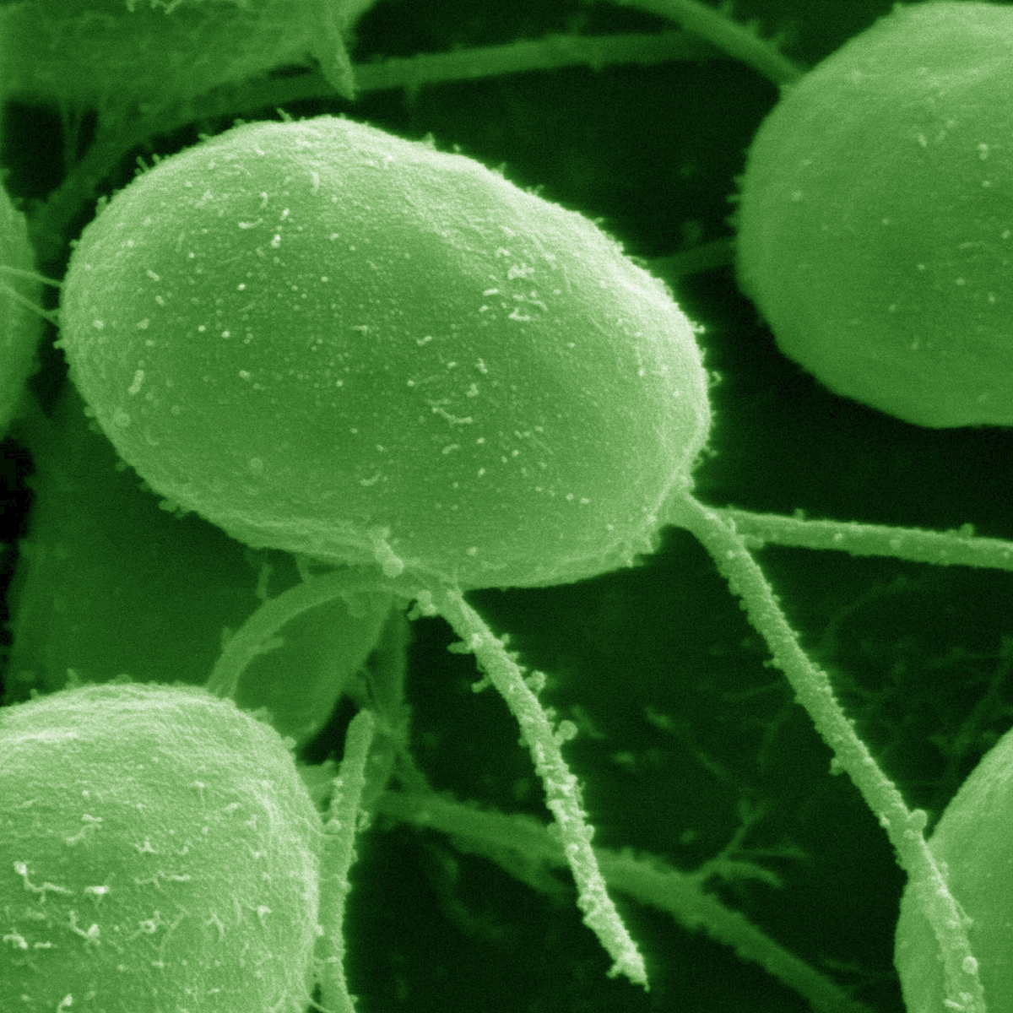
mathematical models
Human well-being
Community
Population
Individual
Subcellular
data science & synthesis
experiments
Notes:
I use mathematical theory, including population growth models and multispecies models, which I test using experiments and data science and synthesis tools

Slide 10
What this course is about
Data wrangling
Data visualization
Programming in R
Ecological data synthesis and analysis
Communicating science (writing, graphing, presenting)

Slide 11
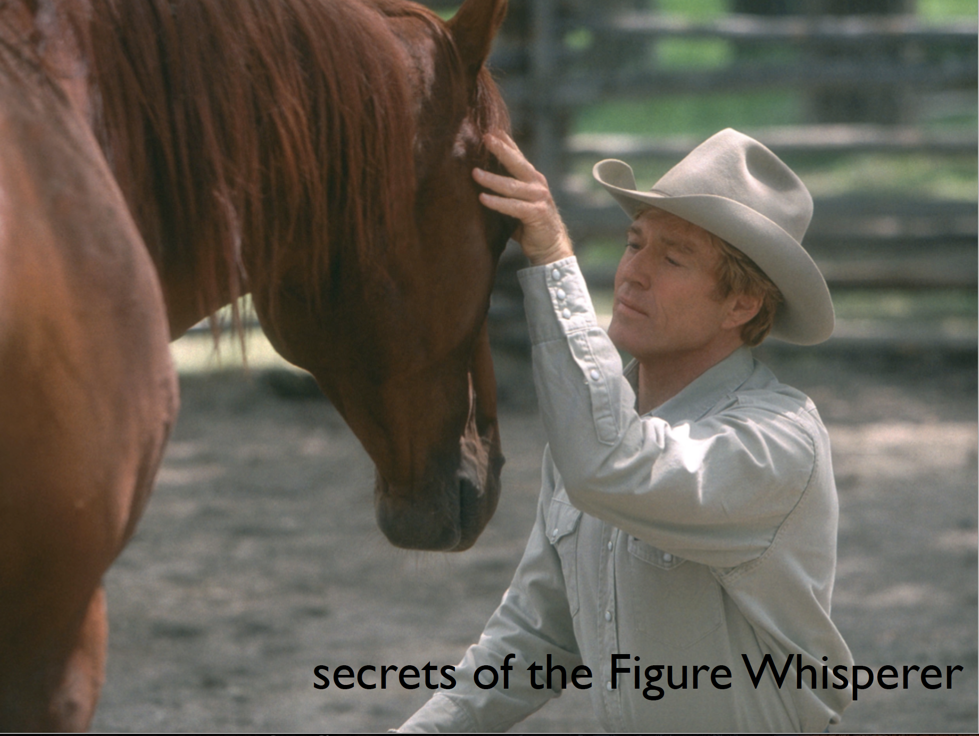
image from Jenny Bryan

Slide 12
In my experience, the vast majority of data analysis pain is due to insufficient data wrangling.

Slide 13
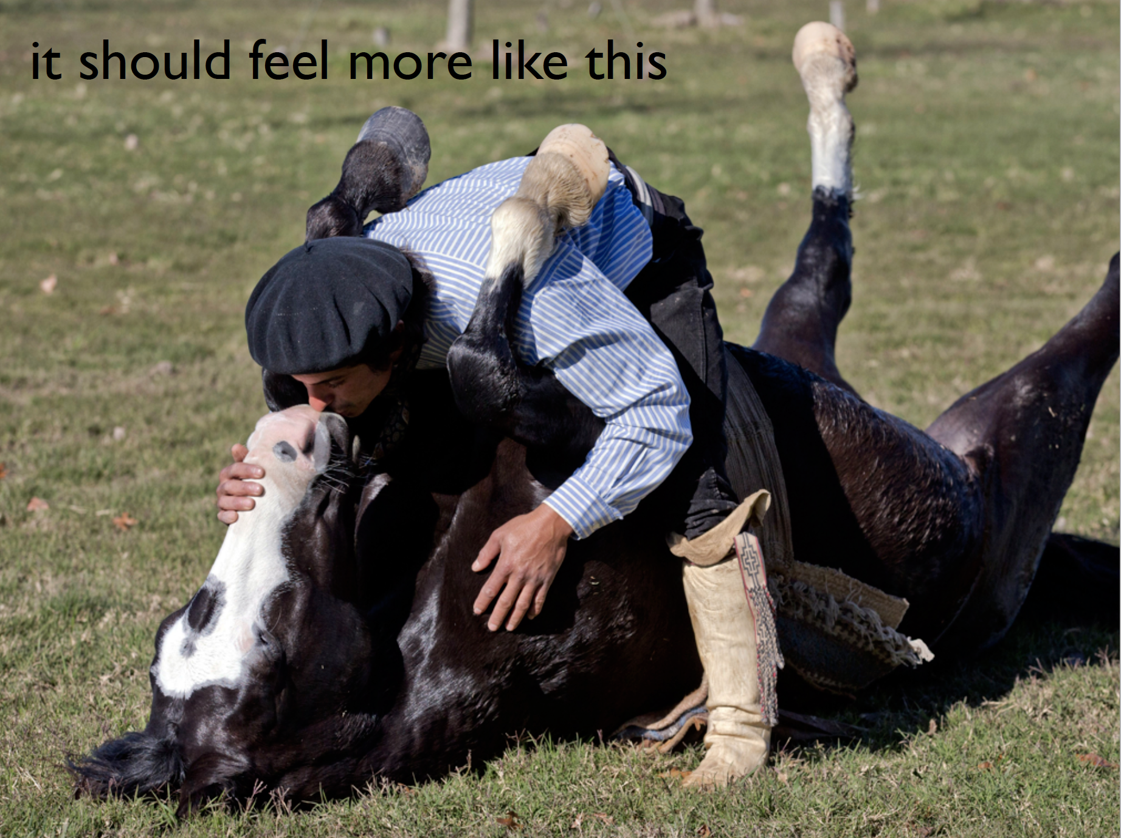
image from Jenny Bryan

Slide 14
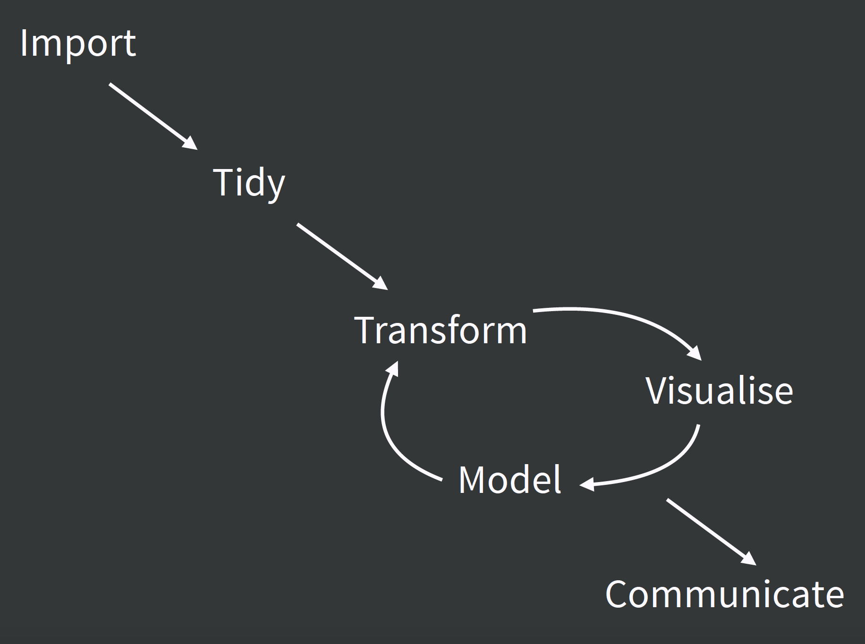
Reproducible, sensible workflows

Slide 15
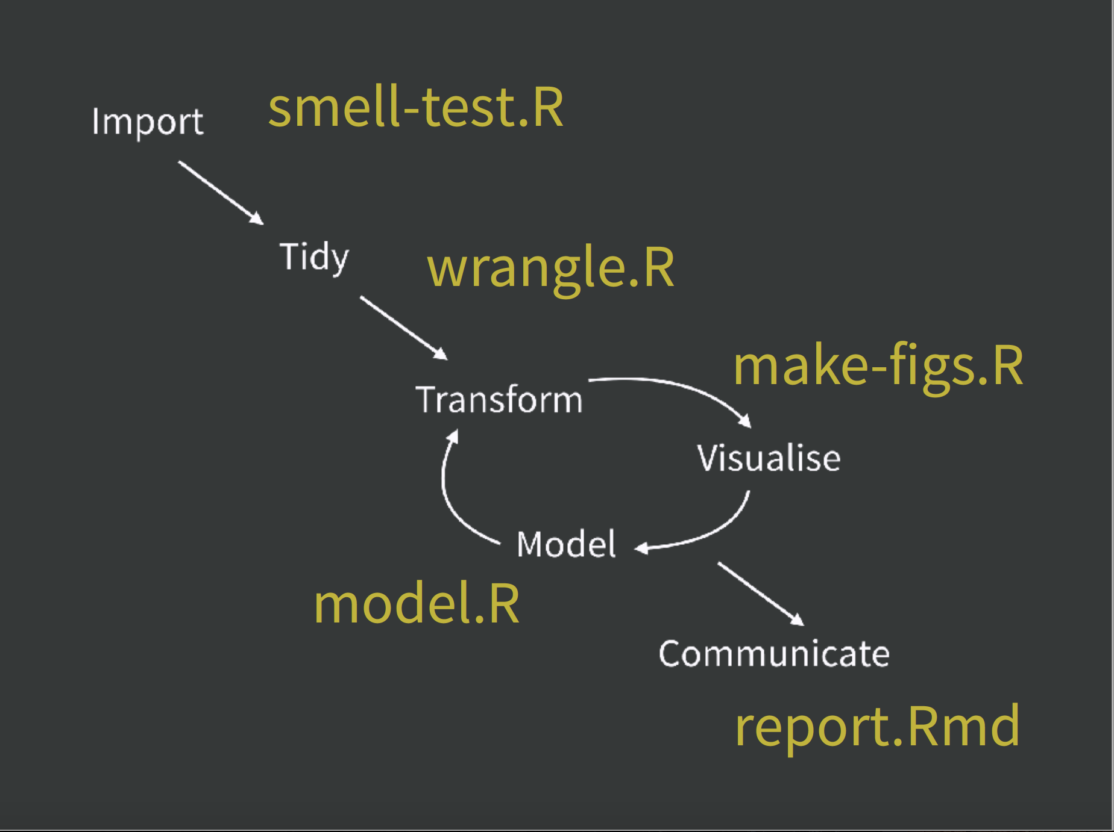

Slide 16
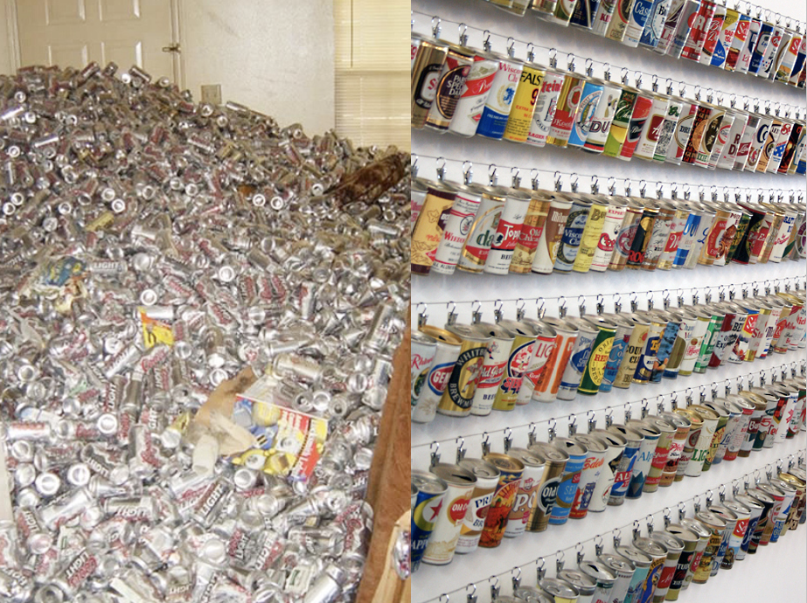

Slide 17
image from Jenny Bryan

Slide 18
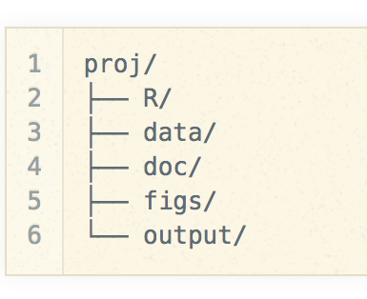
image from Jenny Bryan

Slide 19
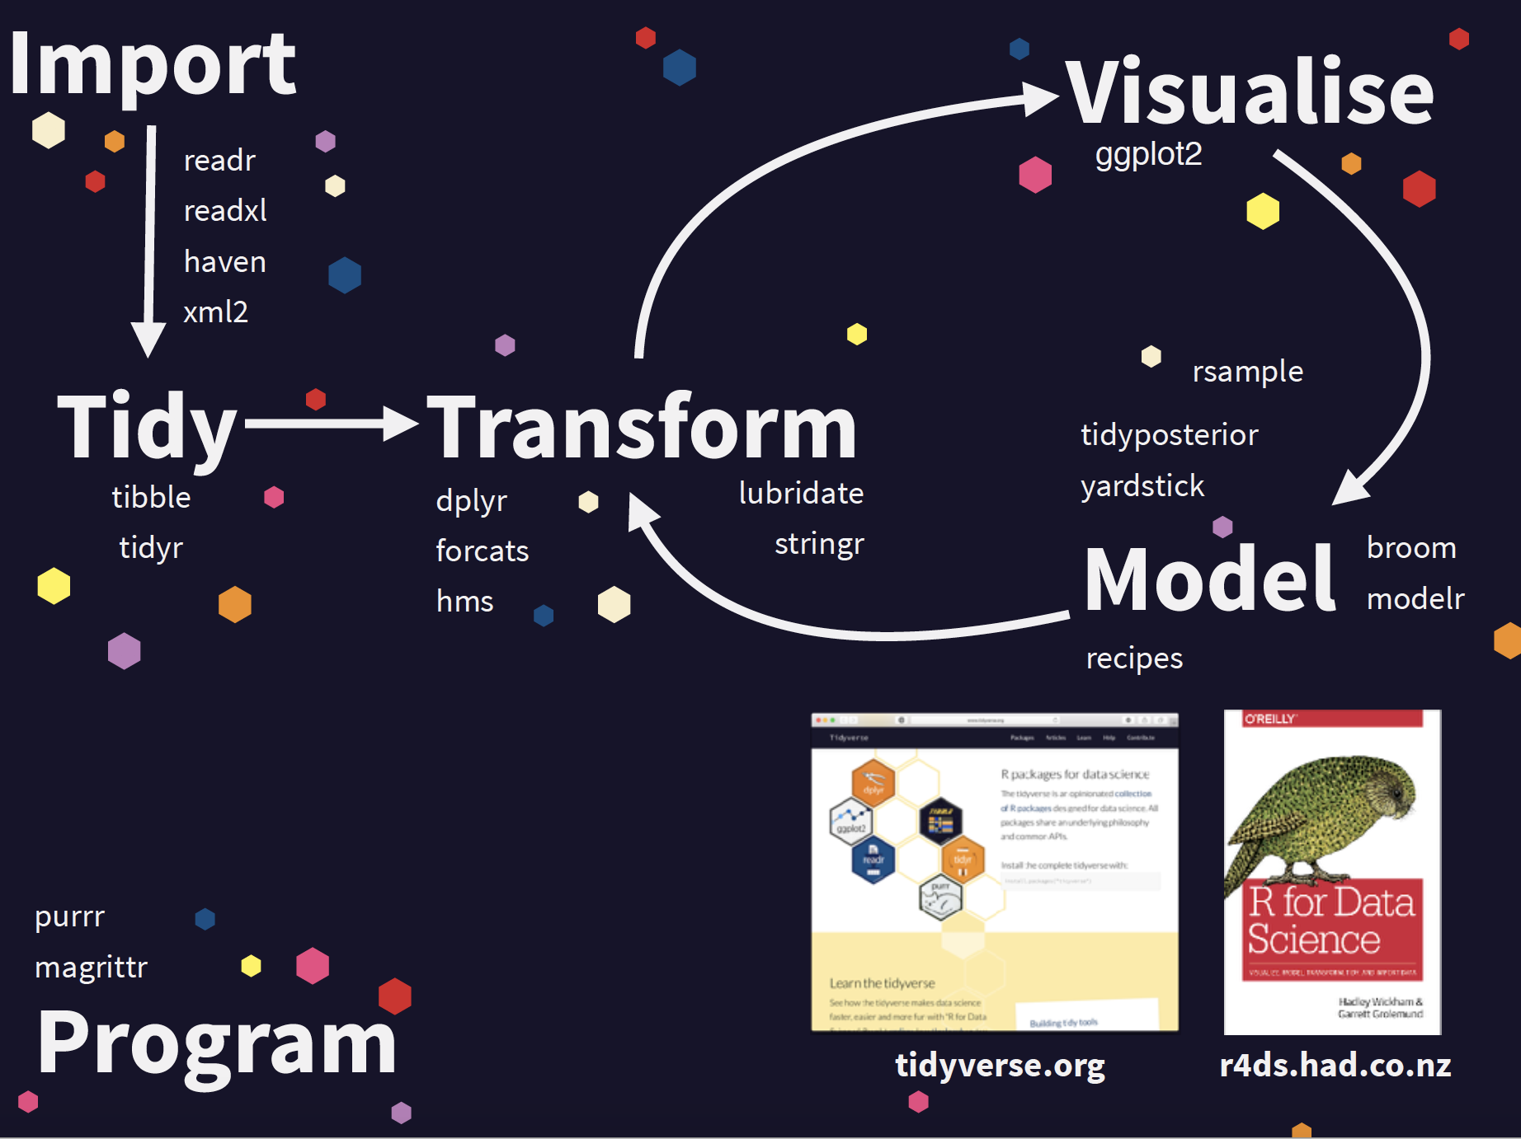

Slide 20
“pit of success”

Slide 21
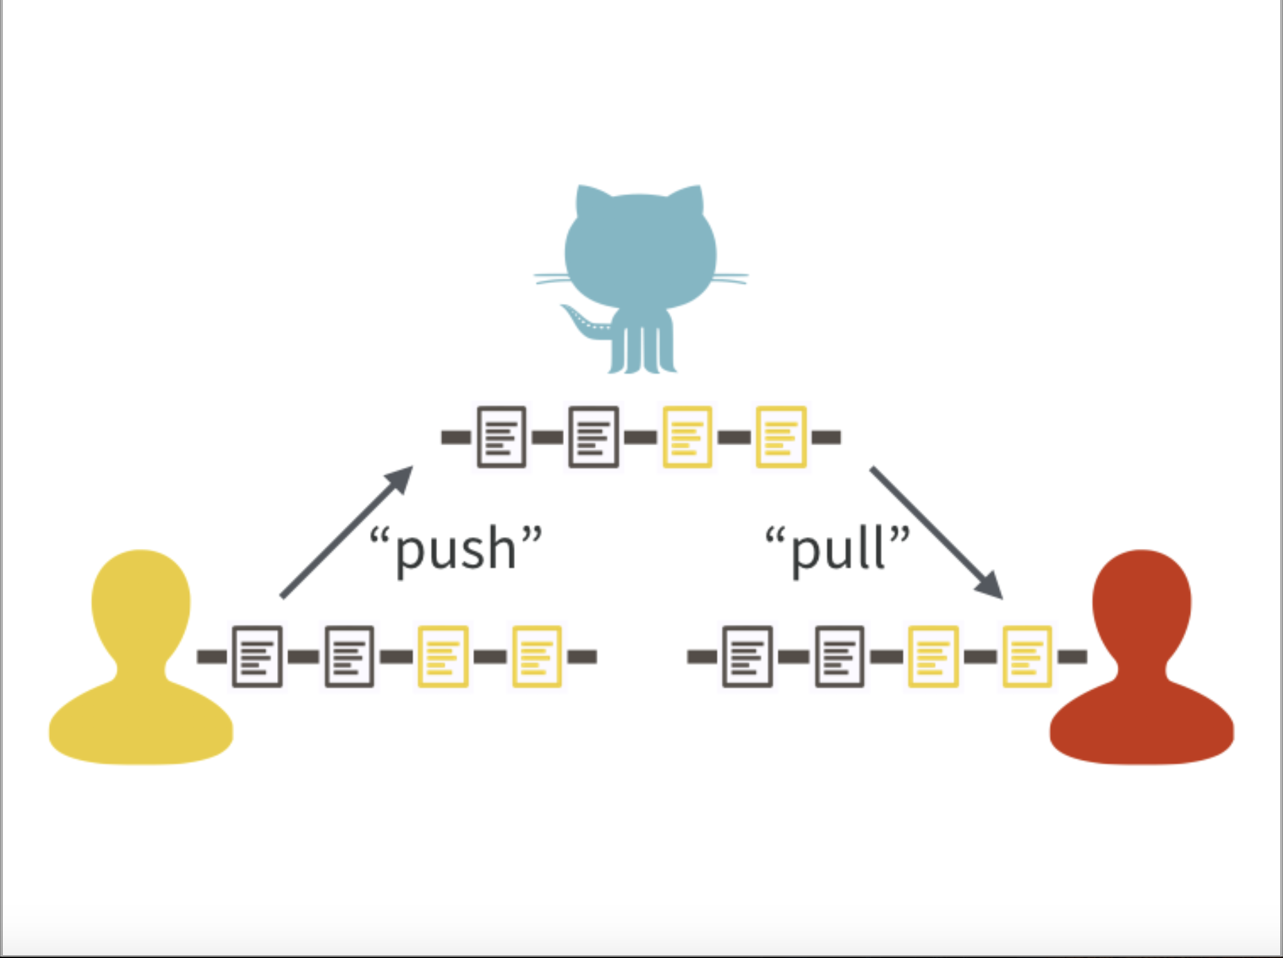
Version control using git + GitHub

Slide 22
Code of conduct
A harassment-free experience for everyone, regardless of age, body size, disability, ethnicity, gender identity and expression, level of experience, education, socio-economic status, nationality, personal appearance, race, religion, or sexual identity and orientation.

Slide 23
Course mechanics
2 lectures a week + 1 lab
All class components will operate on GitHub (materials, homework etc)
Focus on workflow
Lots of in class live coding
Lots of experience working with “wild caught data”

Slide 24
Learning outcomes
By the end of the course, students are expected to be able to:
Implement R’s ggplot2 and Shiny to generate static and dynamic graphics.
Understand the key components of data visualization theory and the encodings of a statistical graphic.
Describe key modern plot types and their uses for exploratory data analysis.
Analyze and draw conclusions from data using exploratory data analysis.
Make effective design choices when producing a data graphic.
Read data into R from standard (e.g., .csv) text files, as well as common spreadsheet file types (e.g., .xls).
Manipulate a single data table in R, to do things such as: filtering rows based on a combination of criteria; selecting variables; creating new variables and modifying pre-existing ones, etc.
Define tidy data and explain why it is an optimal format for data analysis involving rectangular data in R.
Transform data into the tidy data format in R using tidyr.
Understand the key data structures in R.
Manage and manipulate data with dates and times, missing values and categorical variables in R.
Rename data frame columns.
Data visualization components
Data wrangling components

